Slide 1
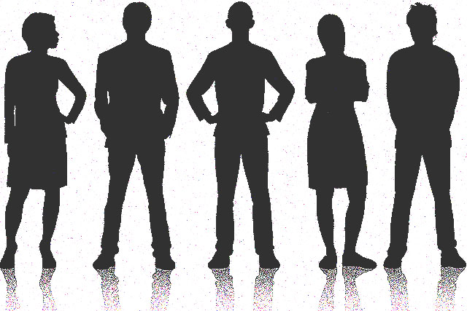





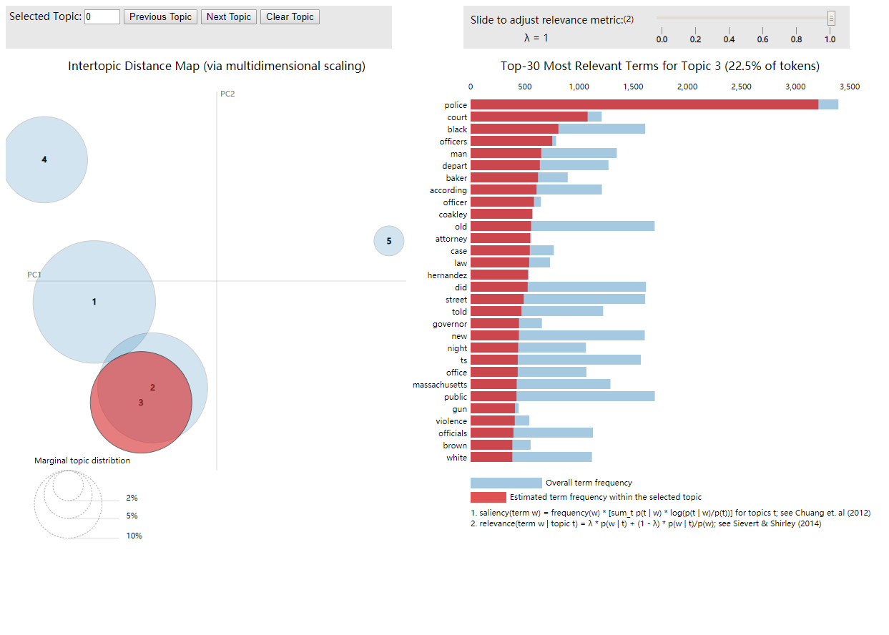
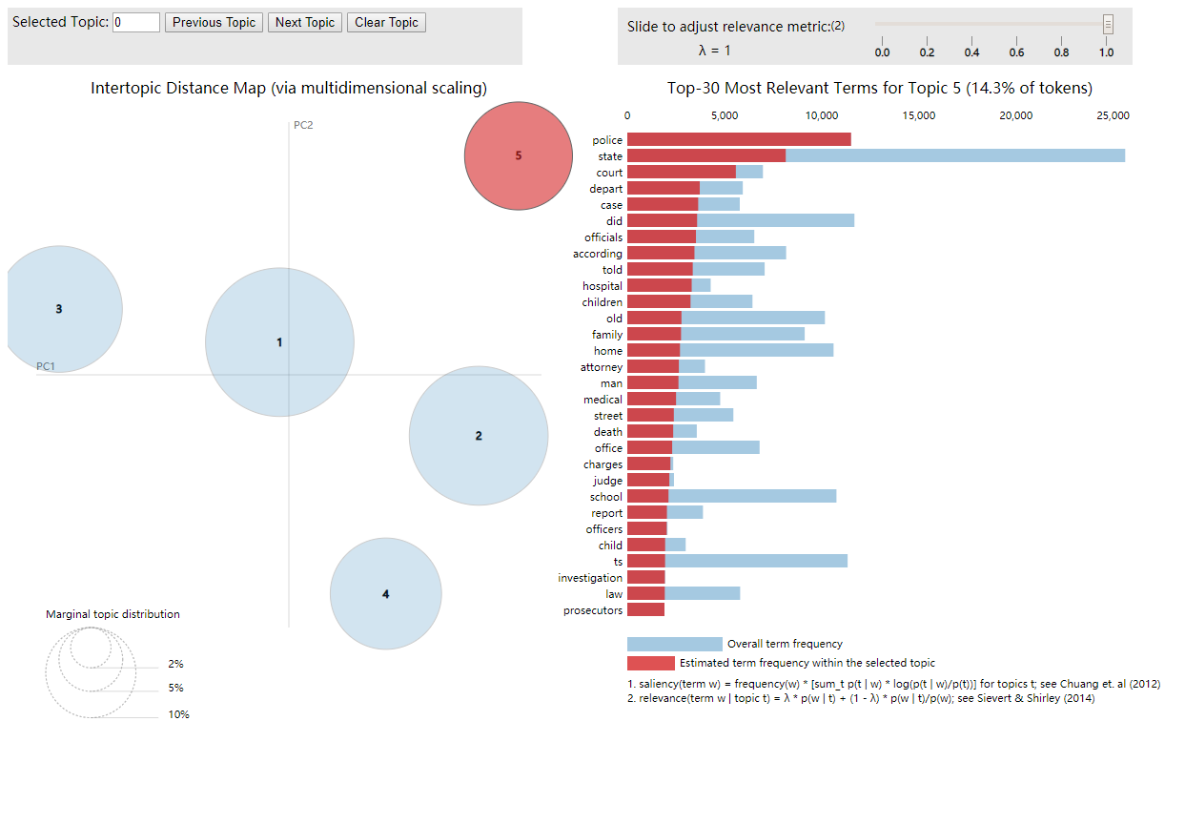
NAACP Media Research
Yufeng Chen, Jiaqi Sun, Ruotian Liu | CS 506 - Spark! Project
Problem Statement
Total data Size: ~1GB
Boston Globe: ~200000 pieces of news, ~24000 about black
WBUR: ~30000 pieces of news and articles, ~2800 about black
WGBH: ~1500 pieces of news and articles, ~150 about black
The National Association for the Advancement of Colored People (NAACP) is a civil rights organization in the United States, formed in 1909 as a bi-racial endeavor to advance justice for African Americans. Their goal is to ensure the political, educational, social, and economic equality of rights of all persons and to eliminate race-based discrimination.
In this project, we are going to help our client, NAACP Boston, to understand the coverage of Boston Media in covering Boston’s Black people and Black neighborhoods. We are going to assess the volume of coverage, the general sentiment of all reports, the topics covered, and how this has changed over time. To do so, we need to collect data from newspaper and radio websites (Boston Globe, as well as WGBH and WBUR), design algorithms to understand the data, then draw some conclusions. We think the results we get can provide a good view on how the media in Boston did in the past 5 years (from 2014 to 2018). Hopefully, these results will lead our client to some possible ways that can help the media to do better on the elimination of racial hatred and race-based discrimination.
Data
&
Results
What We Have Achieved
Coverage
Sentiment
Methodology
Collecting Data: To collect articles from website, we first tried a python module named “BeautifulSoup”. It could work correctly for us to get the articles after adding some restriction to it, but it’s just too slow and not acceptable because we need to get the news in recent 5 years from 3 different websites. Then we tried Scrapy. After got the structure of the websites we want to scrape and find out which class the article part lies in, we successfully got the data we want.
Filtering: After collecting all data we need to see which articles are about black people or black neighborhoods, so wrote an algorithm that can traverse all text data we’ve got and judge whether it was related to black neighborhood or not using a keyword list we’ve collected before (including black neighborhood names and some other words about black people).
Sentiment Analysis: We tried to train a model just like what we did in the midterm to judge an article’s sentiment but couldn’t find a very good train dataset, so the results are not very satisfying. Then we planned to use some existing sentiment analysis tools to do the job. Finally we decided to use ‘VADER-Sentiment-Analysis’ to help us determine if a piece of news is positive or negative after testing on some sample articles.
Getting Topics: The next step is to find out what topics are popular. In a word, our analysis was based on word count. We vectorized the article and tried to get rid of the influence of meaningless words for drawing conclusion like “said”, “Boston” or “Monday” from two aspects. The first one was to remove all the words in our keywords used for filtering and in stop-word list since those were a common part of relevant articles. The second one was tf-idf algorithm. As we learnt in class, tf-idf was born to deal with this problem. The following step was a classification problem. We tried different models we used before and choose LDA (Latent Dirichlet Allocation) to do the classification job because it worked pretty well with text classification and it could provide a nested dimensionality reduction API so that we can make our result visible easily, which was quite clear to evaluate and show our results.
Topics
Boston Globe’s top topics in news about black
2014 top 5 topics | 2015 top 5 topics | 2016 top 5 topics | 2017 top 5 topics | 2018 top 5 topics
police court black officers man | snow 2024 olympic line south | school students black schools community | xa0 street team sox day | black white trump president american
percent 000 public health students | school students percent schools public | police officers man old street | trump president white jackson black | police street officers man court
council wall keolis contract councilor | police officers street man court | massachusetts 000 public housing million | life children family father mother | school students schools public percent
world black new american african | black life white hernandez day | day world new way old | school students percent million schools | massachusetts health depart public office
school menino mayor day family | work new building food home | trump clinton campaign president voters | police depart court officers according | life day world way xa0
‘crime’ topic - black
‘crime’ topic - all

